Slide 1

Identify Car Wash Services

Slide 2
Hackathon
Topic – Identify Car wash Services
GROUP-6
Employee ID
Name
2252032 Manish Kumar
2252560 Masa Priyanka
2252319 Bhavya Pratap Singh
2252149 Mohammed Adnan
2252148 V Rajesh Reddy
Cohort Code - QEA22CSDSD003

Slide 3
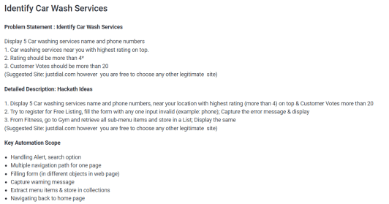
Problem Statement

Slide 4
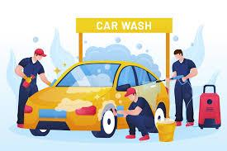


Objectives
Car Wash Services
Display 5 car services name, Rating should be greater than 4 and customer votes should be greater than 20.
Register for a free listing
Display the error message.
Fitness
Display all the sub-menu items and store in a list of under Fitness, GYM.

Slide 5
Agenda
Automation Testing
&
Test NG
Framework
Automation Tools used in the Project
Stages
Of
The
Project
Project Structure/
Coding
&
Outcomes
Test Report
Analysis

Slide 6







Popular Automation Tools
Selenium
QTP
Sikuli
Appium
Jmeter
TestNG
Zephyr
UFT

Slide 7
Website, Framework and Tools used
Website : https://www.justdial.com/
Selenium : Portable Framework for testing web applications and automating the process.
Java : High level programming language.
Eclipse : Integrated Development environment for various Programming Languages.
TestNG : Open source testing framework.
Maven : Software and project management tool.
POM : Object Repository design pattern.
Jenkins : An open source automation server for continuous integration.

Slide 8



PHASES OF PROJECT
Test Cases
POM
Test NG
Maven
Results

Slide 9
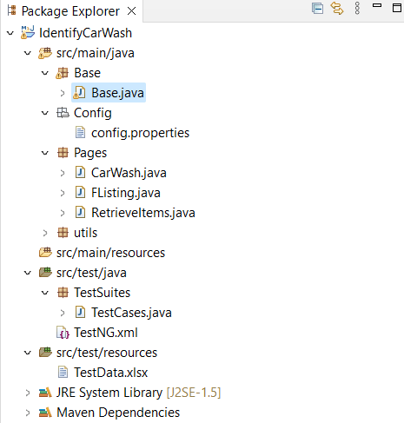
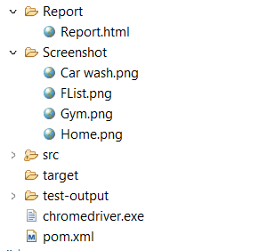
Project Structure

Slide 10
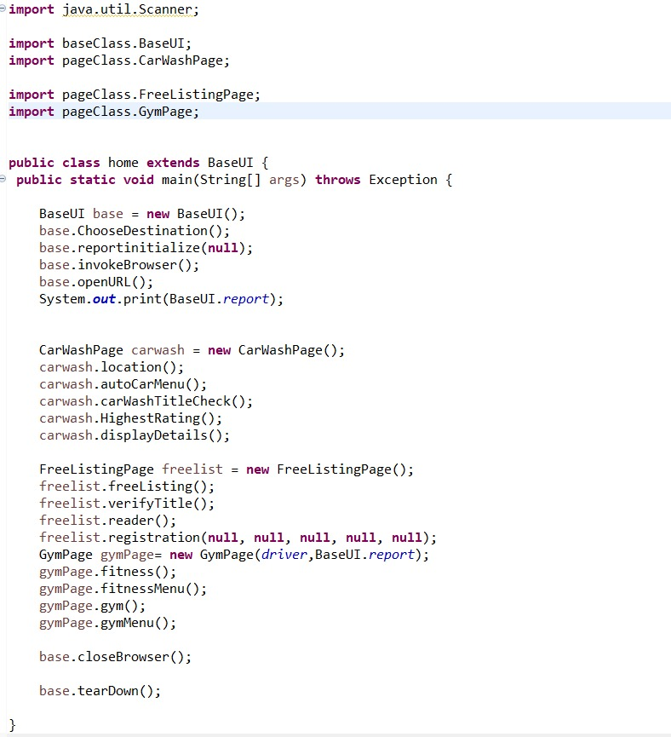
Home.java

Slide 11
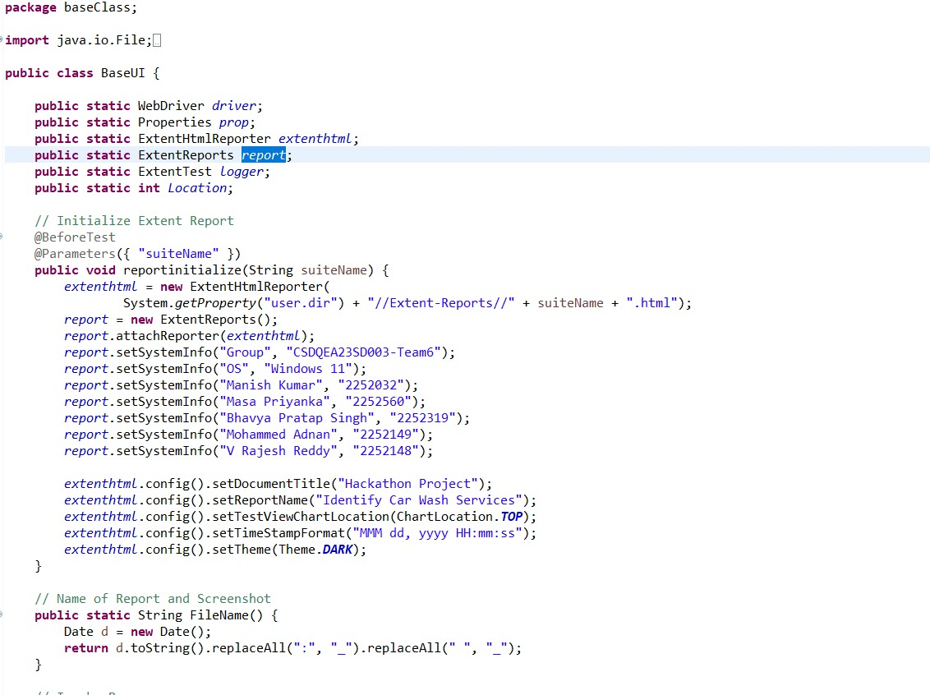
BaseUI.java

Slide 12
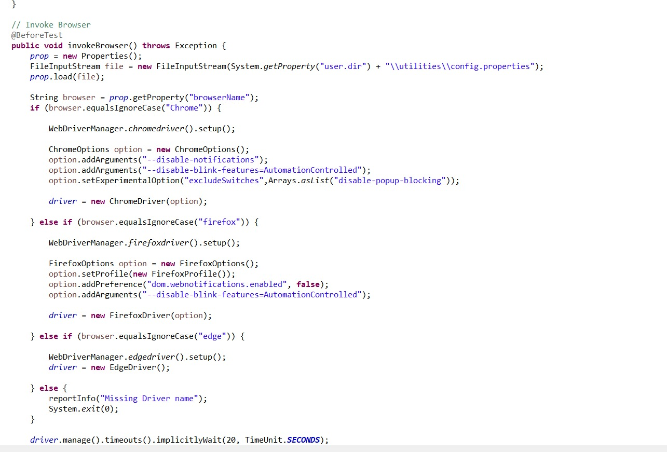

Slide 13
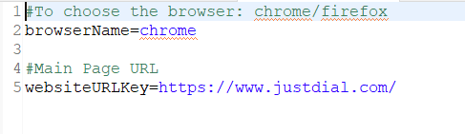
Config.properties

Slide 14
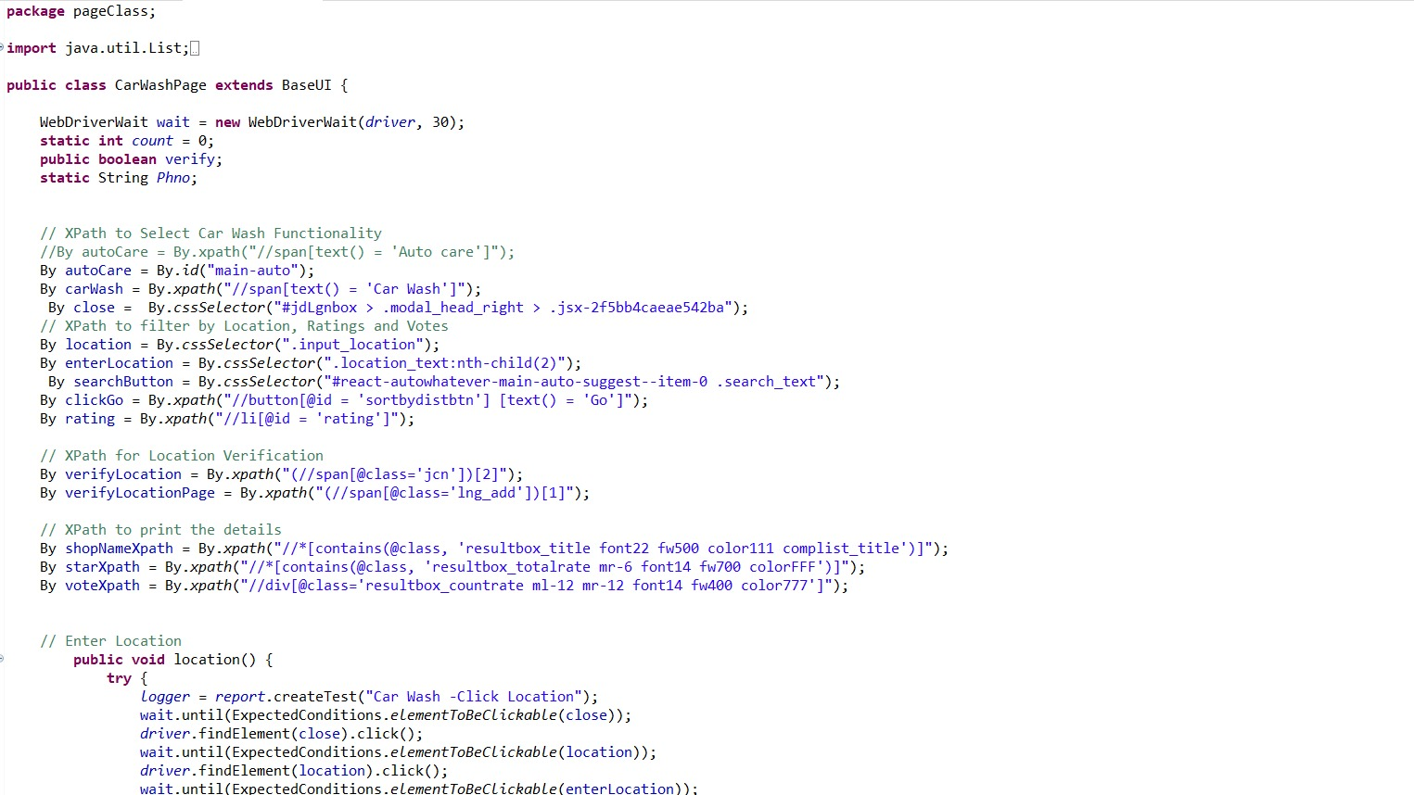
CarwashPage.java

Slide 15
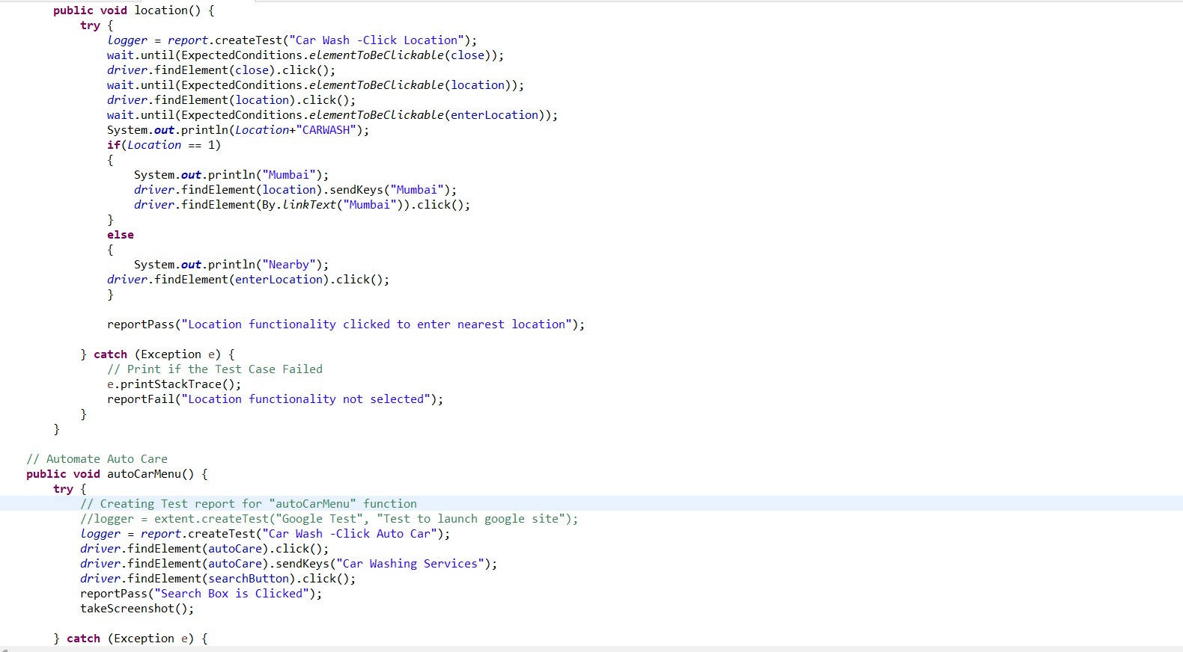

Slide 16
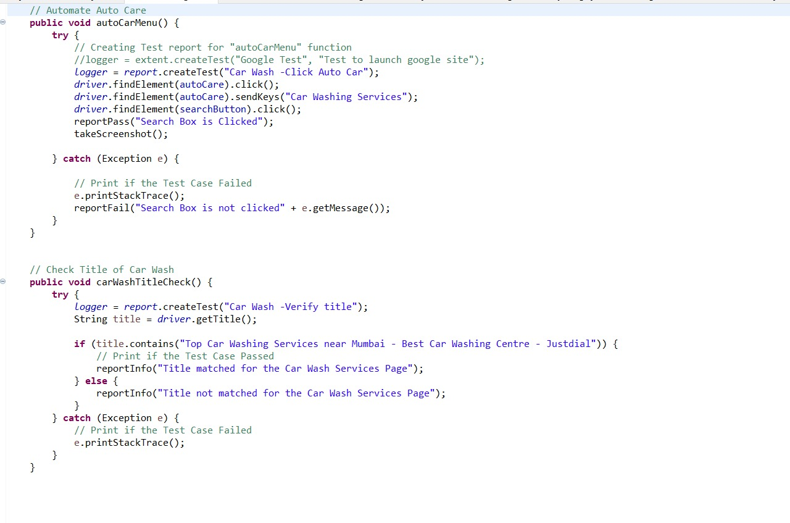

Slide 17
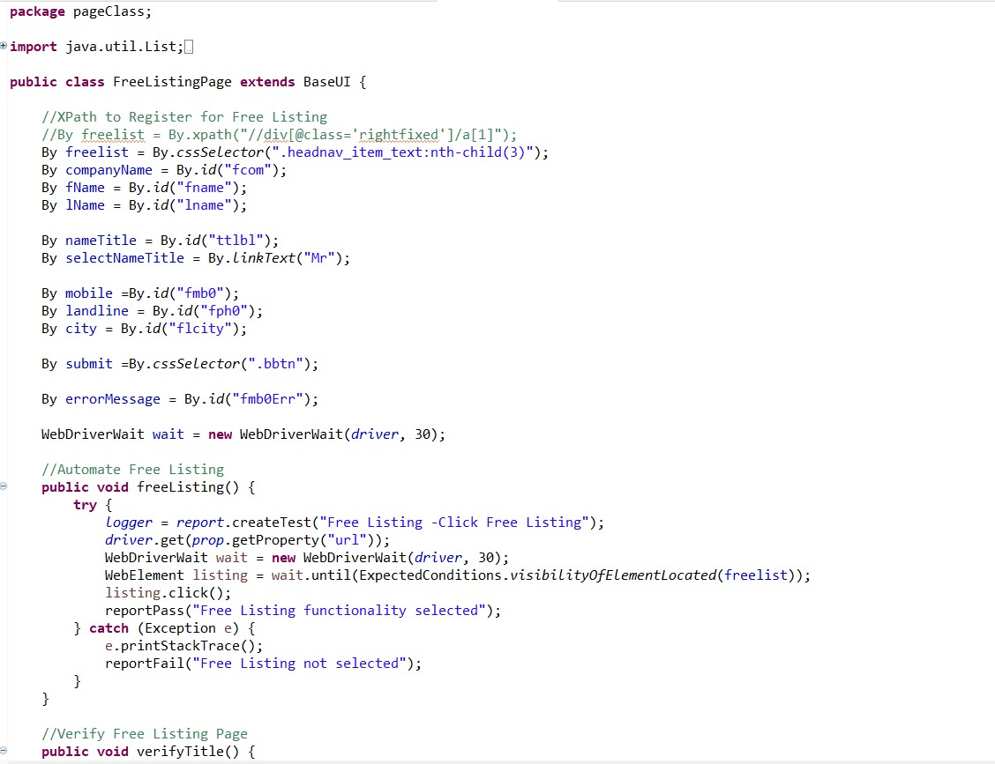
Flisting.java

Slide 18
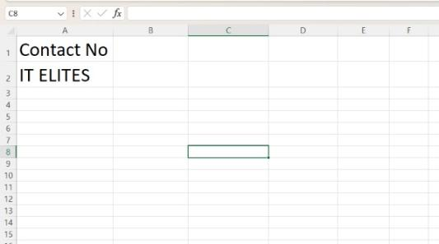
FREE LISTING – ENTER INVALID INPUT

Slide 19
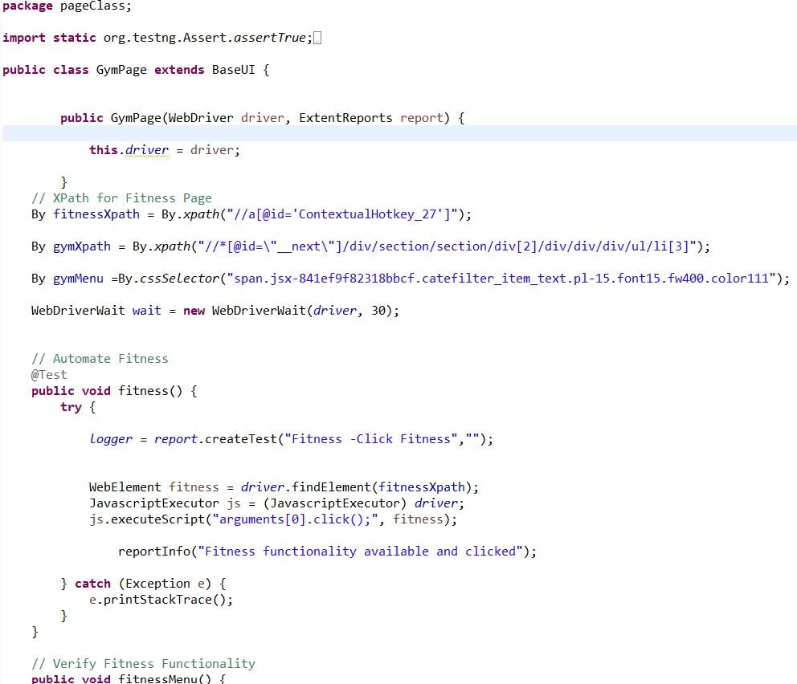
GymPage.java

Slide 20
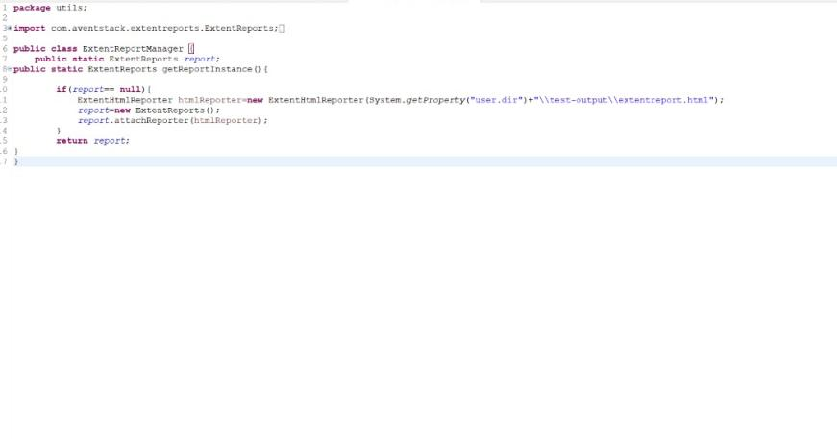
Extent Report manager – test report

Slide 21
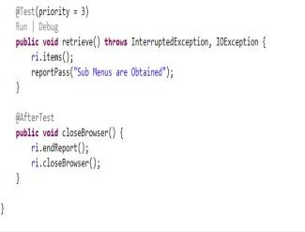
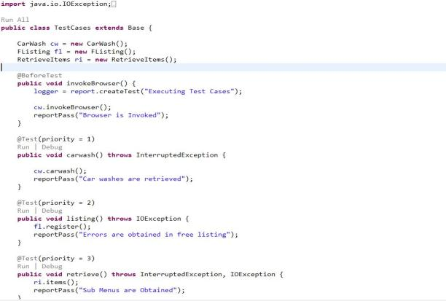
Testcases.java
running Testcases.java & hence the output -
continues ….

Slide 22
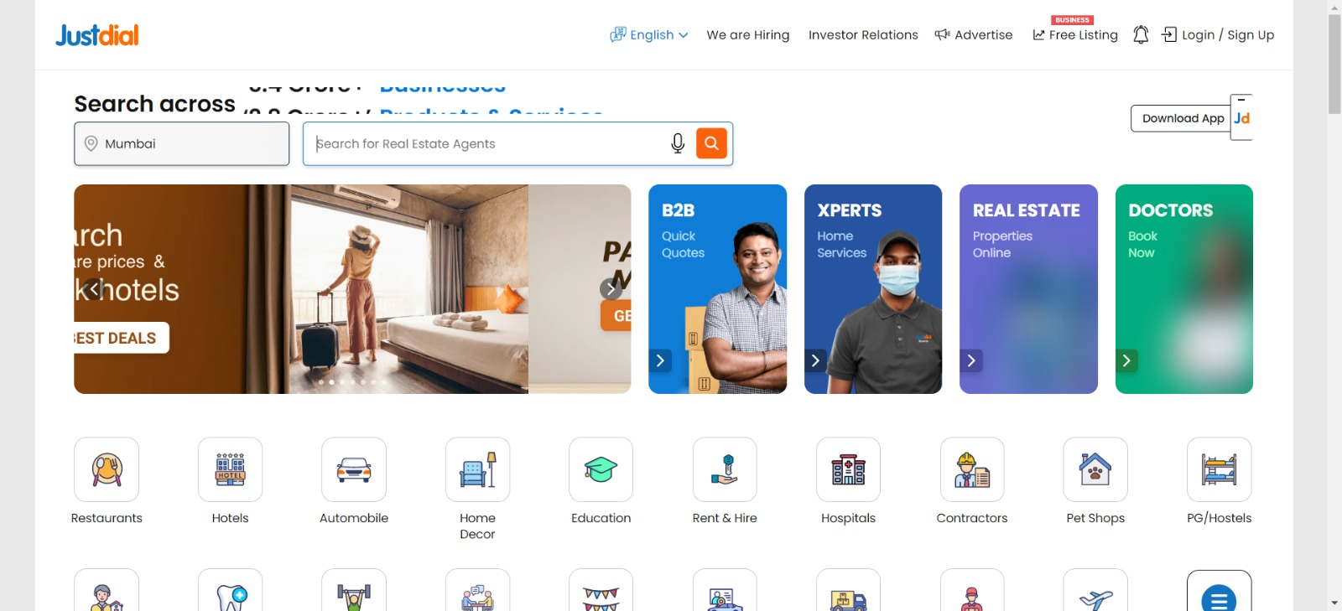
AUTOMATION WINDOW SCREENSHOTS

Slide 23
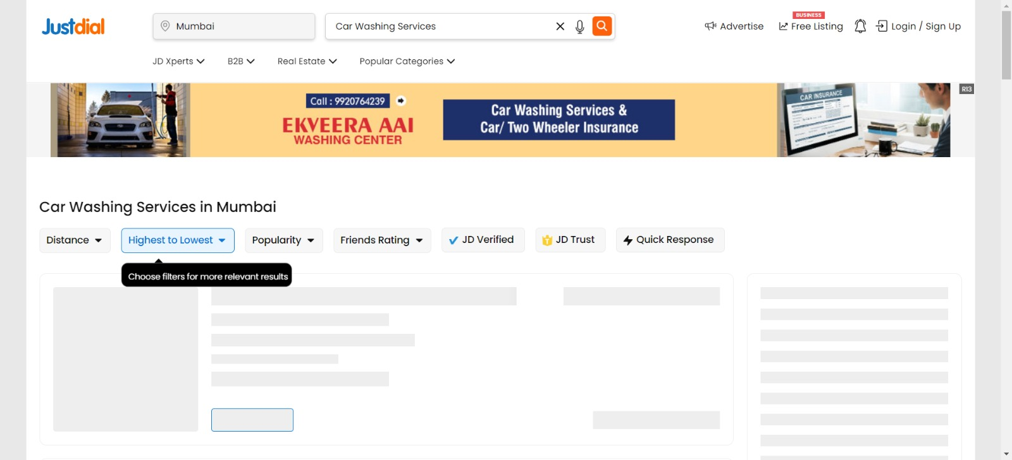

Slide 24
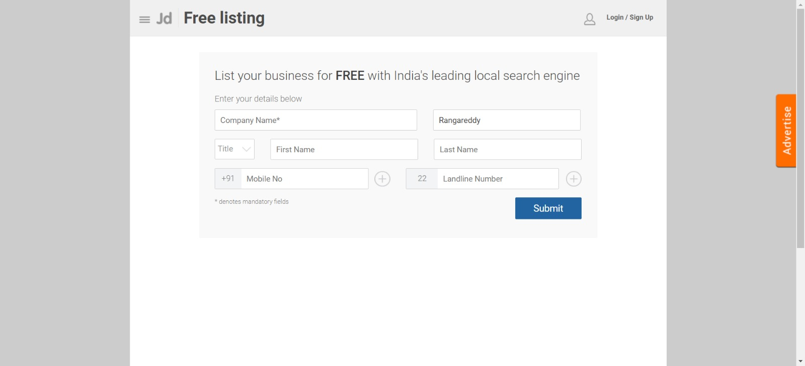
Free listing

Slide 25
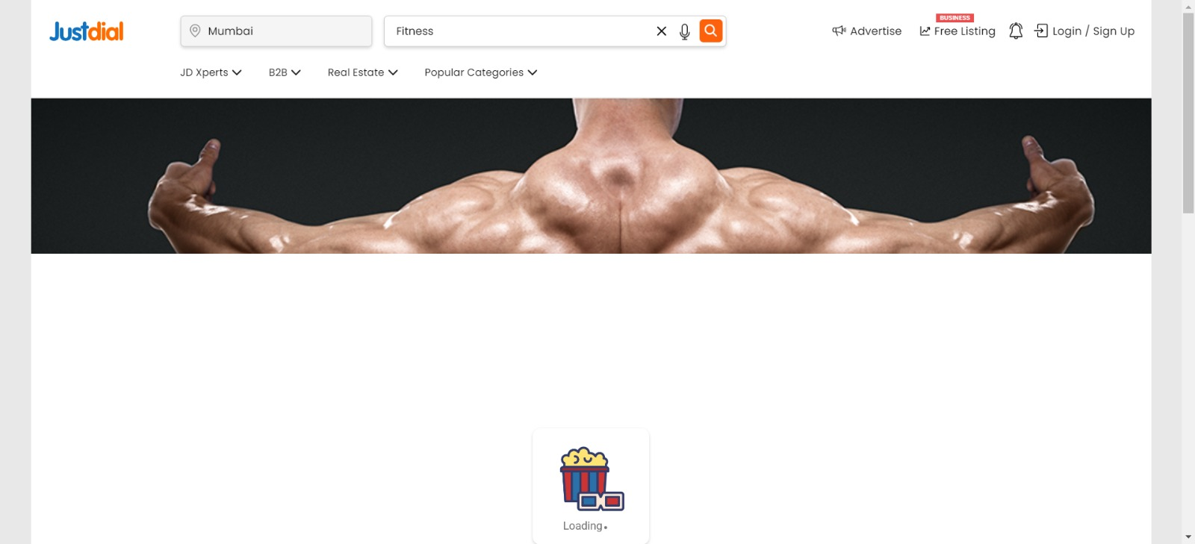
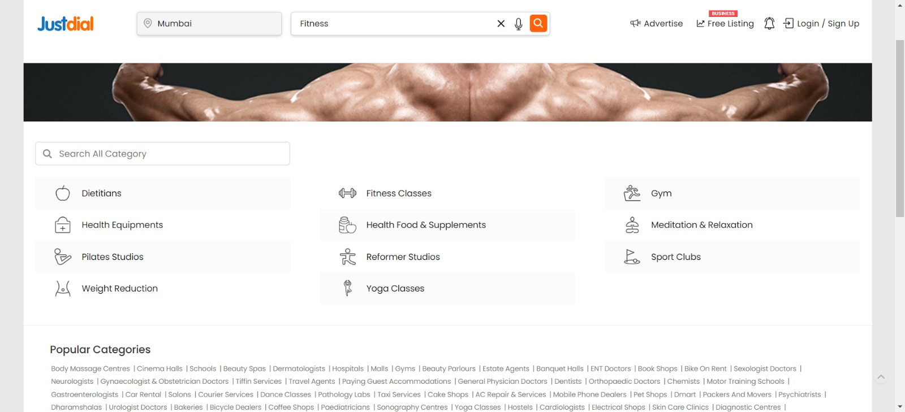
Fitness & Gym

Slide 26
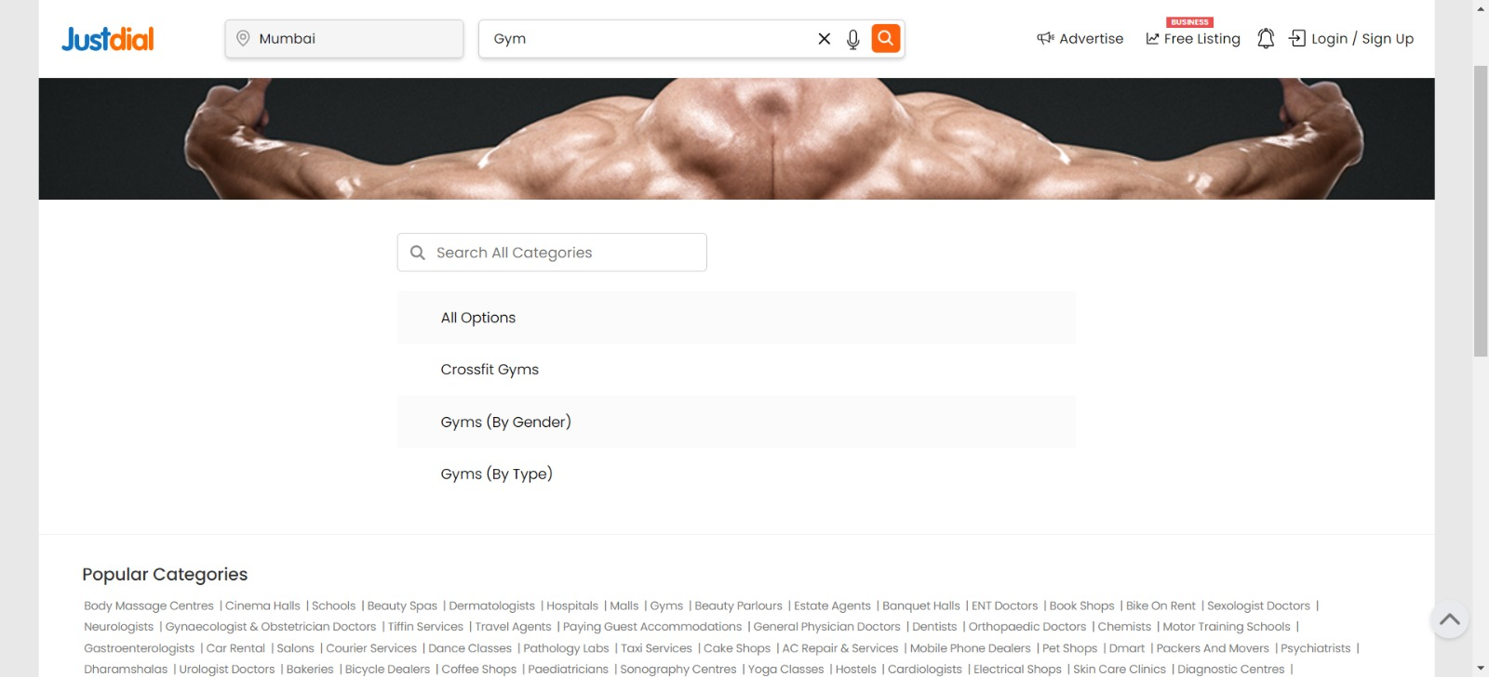

Slide 27
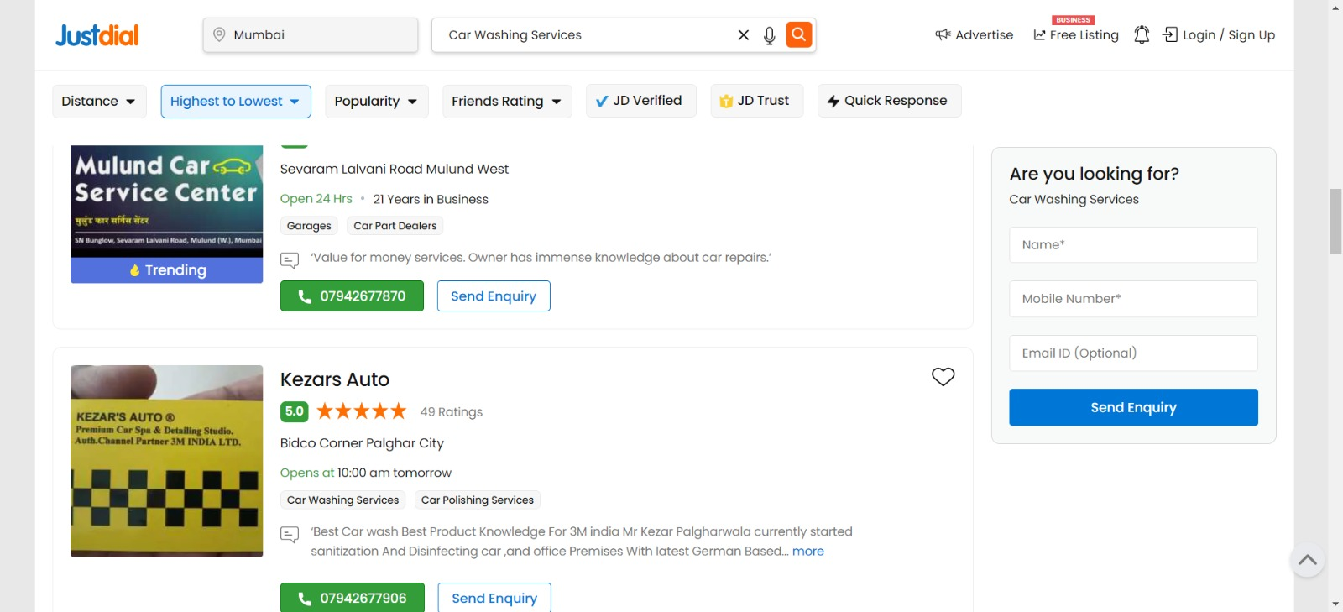
Car Washing

Slide 28
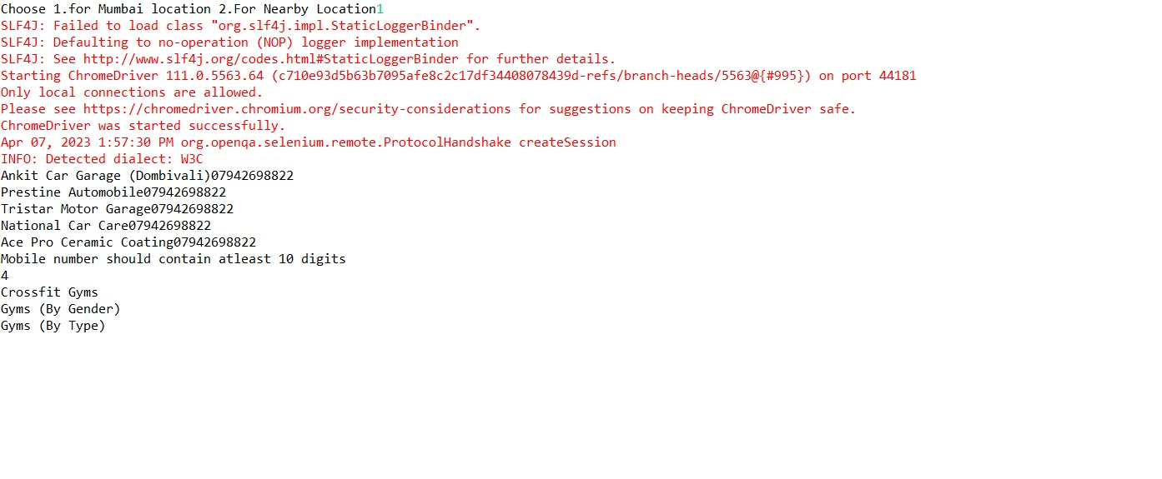
Console output

Slide 29
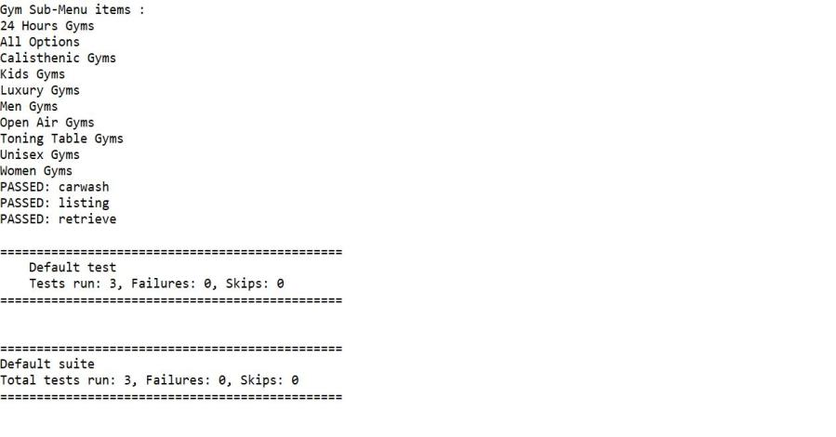
Options in Fitness & Gym center

Slide 30
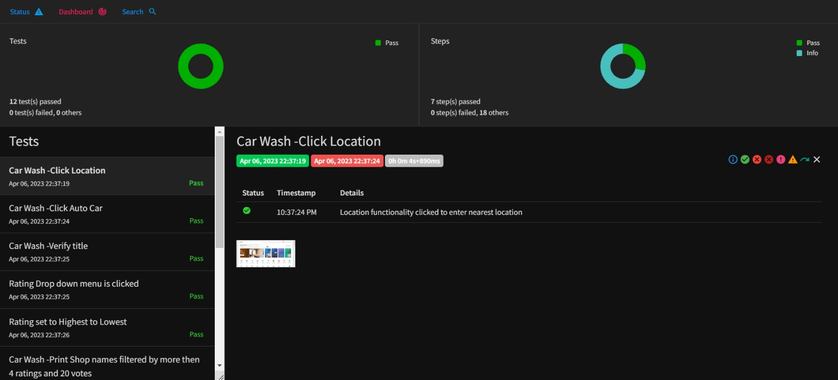
Test Report

Slide 31


